Slide 1


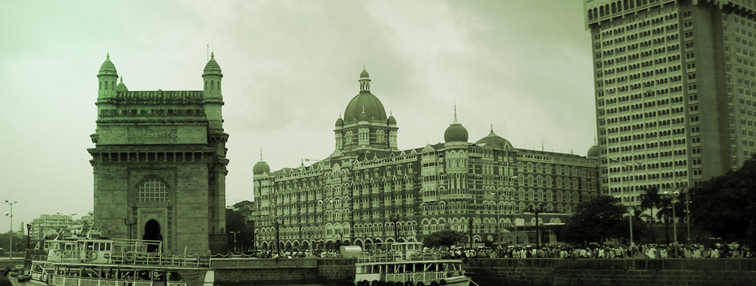
www.asno2013.org
10th Meeting of the ‘Asian Society for Neuro-Oncology’
Jointly with the 5th Annual Meeting of Indian Society of Neuro-Oncology
March 21 – 24, 2013 | Taj Mahal Palace Hotel, Mumbai, India

Slide 2
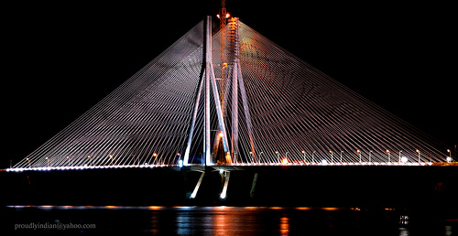
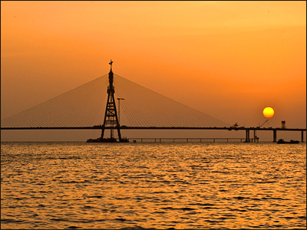
10th ASNO
MUMBAI
21 to 24th MARCH 2013
rjalali@tmc.gov.in
vamahospitality@hotmail.com

Slide 3
ASNO / ISNO 2013
Ab Guha Oration: Roger Stupp
March 21, 2013 | March 22, 2013 |  | March 23, 2013 | March 24, 2013
ISNO Day CME | ASNO | ASNO | Plenary session | QOL sessions and Patient Support Group Activities (BTF India and IBTA)
Presidential Oration Platform presentations | Plenary session Debate/Symposia/ Scientific sessions (3-4 parallel) |  | Scientific session (3-4 parallel) | Closing
Welcome reception | Cultural Programme (NCPA) and Dinner |  | Banquet
www.asno2013.org / www.asn-o.com / www.isno.in / www.braintumourindia.org

Slide 4
Confirmed International Faculty
Roger Stupp, Switzerland
Susan Chang, USA
Michael Prados, USA
Raymond Sawaya, USA
Mark Gilbert, USA
Eric Bouffet, Canada
Arnie Perry, USA
Tracy Batchelor, USA
Minesh Mehta, USA
Steven Rosenfeld, USA
Joachim Baehring, USA
Frank Furnari, USA
Normand Laperriere, Canada
Paul Northcott, Germany
Amar Gajjar, USA
Terri Armstrong, USA
Manmeet Ahluwalia, USA
Chas Haynes, SNO, USA
Denis Strangman, IBTA, Australia
David Reardon, USA (TBC)
Chandranath Sen, USA (TBC)
And all renowned ASNO and ISNO Faculty

Slide 5
ASNO 2013
MUMBAI
March 21-24 2013
www.asno2013.org
Venue: TAJ MAHAL HOTEL (Iconic world famous hotel)
Registration : Ongoing (Attractive Residential Rates)
Abstract Centre: Open (last date: 23rd December 2012)
Social Events: Exciting Classical Music Recitals at the National Centre for Performing Arts (NCPA)
Tour Packages : before or after the Conference; anywhere in India
www.incredibleindia.org

Slide 6
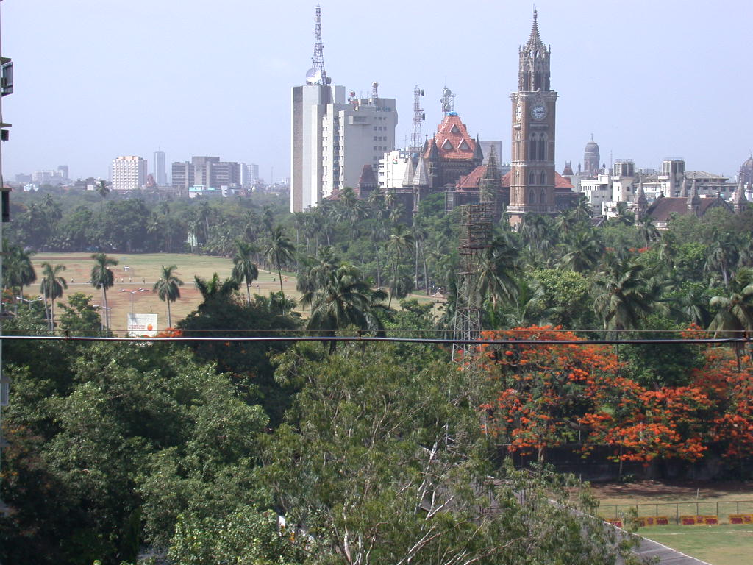
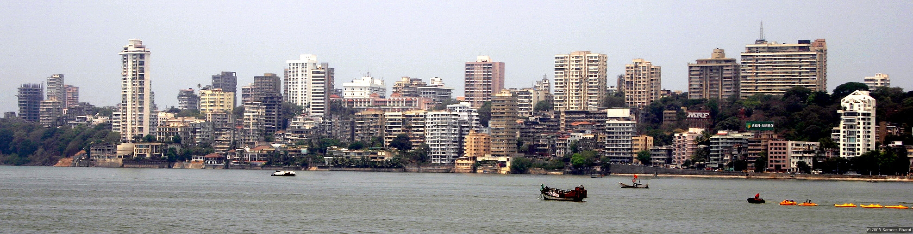
ASNO 2013, MUMBAI, March 21 - 23, 2013

Slide 7
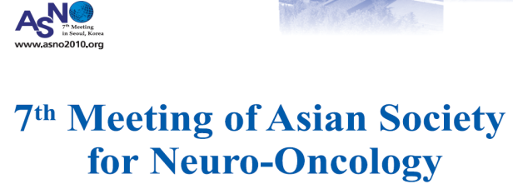
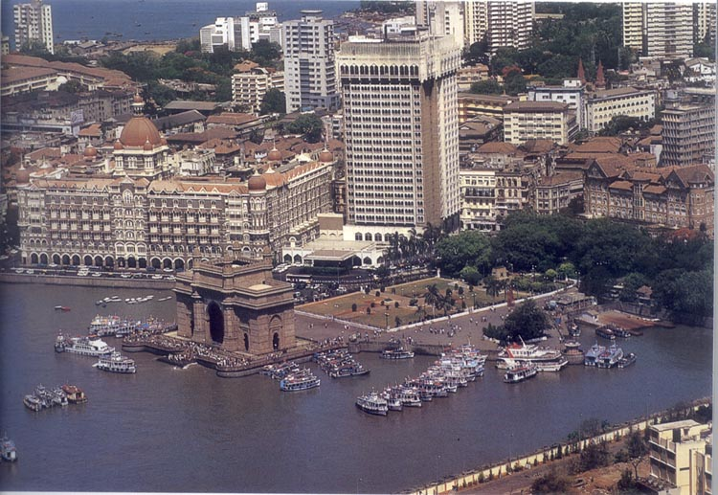
10th
2013
MUMBAI
March 21 to 24, 2013
Notes:
Welcome to the vibrant world of
Performing Arts at NCPA !

Slide 8

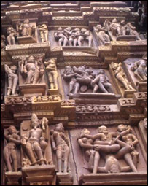
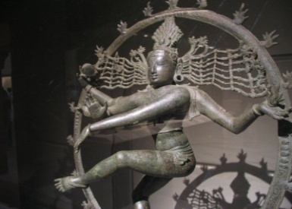

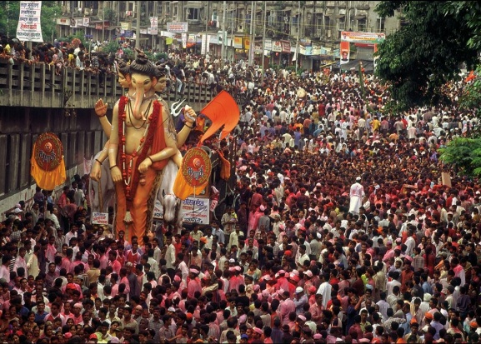
WELCOME to Mumbai
21 to 24 March 2013

